Slide 1
Group 3
103041006彭琍瑄
104034002楊曦
104034006許婷宣
104034037林玟儒

Slide 2
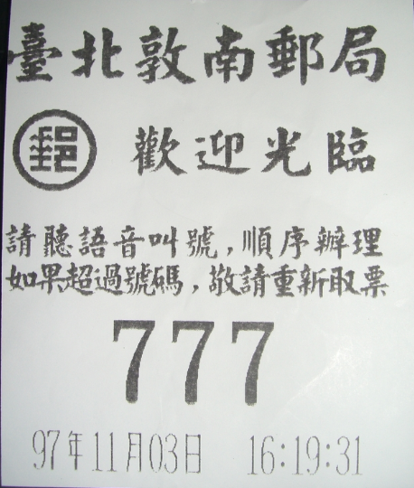
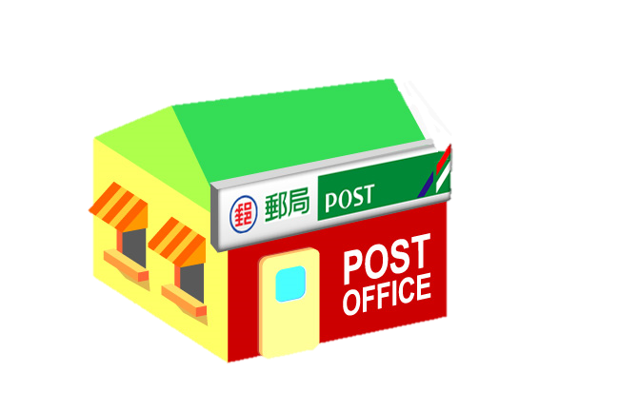

Background
Registered mail
sender’s information
receiver’s information
Notes:
People who want to send a registered mail or express mail or everything like that will have to go to the post office, take the number, waiting for the servers
and write down both sender’s and receiver’s contact information on the envelope, and then give the mail to the server, pay for charges, then the server will give the mail a barcode, send out the mail, the sender can also track the mail with the barcode it’s like an identification for the mail.

Slide 3
Motivation
Many people don’t really know the right position to write
Servers spend time helping people with same things
Post offices are often filled with people
Sloppy handwriting makes postmen hard to identify
Notes:
The reasons why we want to design an additional function for the registered mail are that many people don’t really know the right positions to write. There are senders’ and receivers’ names、addresses, and Zip codes. Some people may even add telephone number、fax number，or the organizations’ sign, which make it even harder to follow all the format the post office required.
As a result, servers usually spend time helping people with same things and thus making post offices often filled with people.
On the other hand, there are people who fill all the information by handwriting. And sometimes sloppy handwriting can make postmen hard to identify.

Slide 4

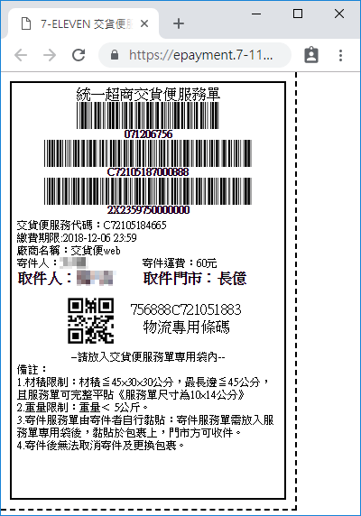
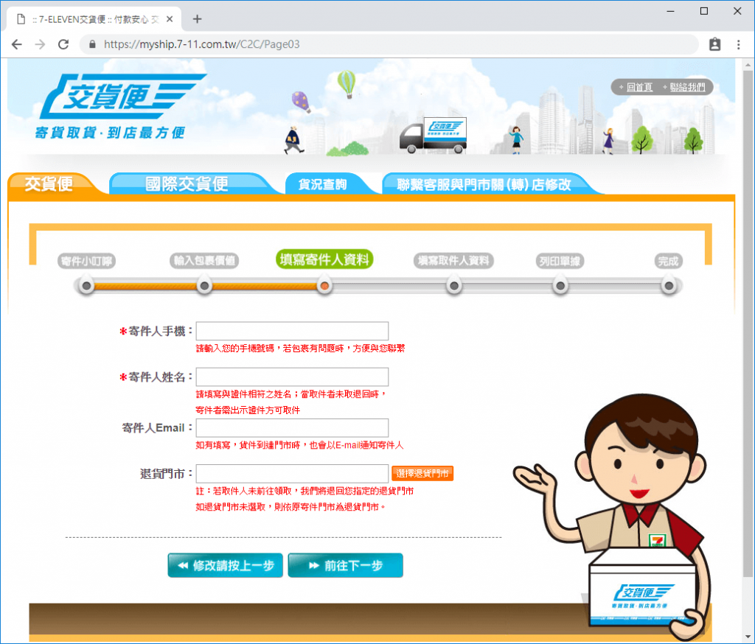
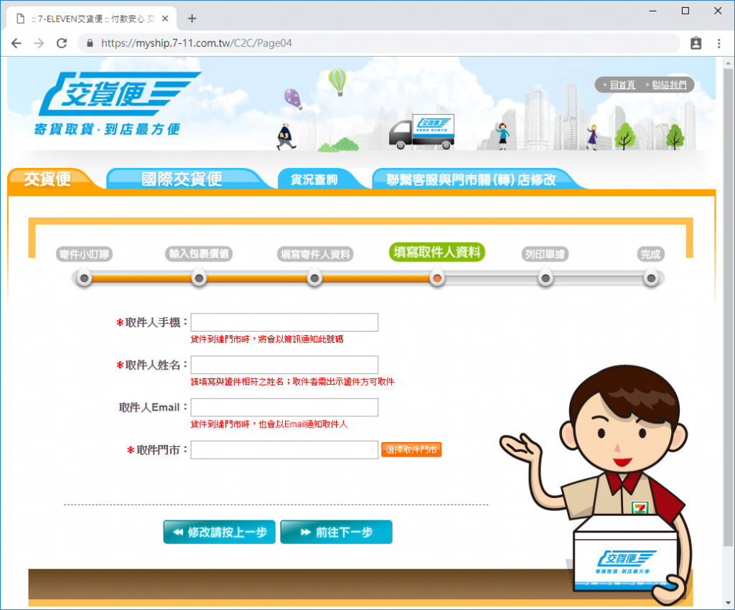
Science
Barcode
7-11 Delivery Service
sender’s information
receiver’s information
Notes:
One of the successful examples is 7-11’s Delivery service,

Slide 5

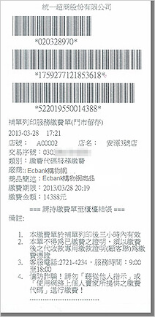
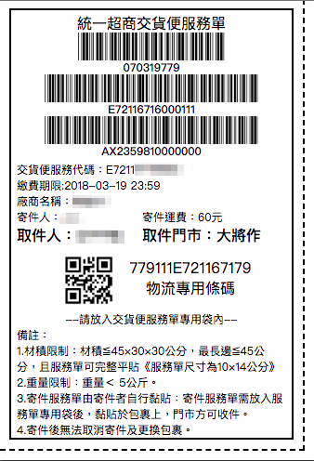
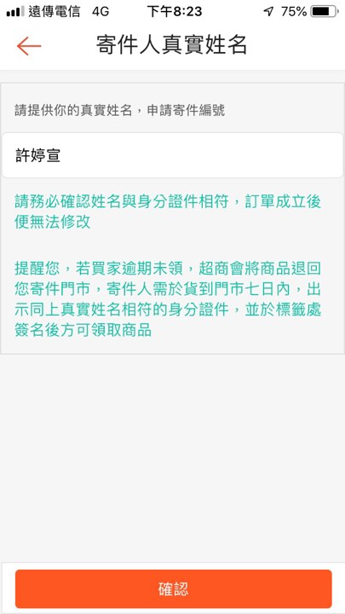
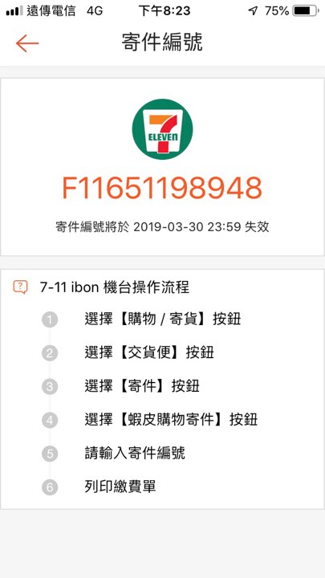
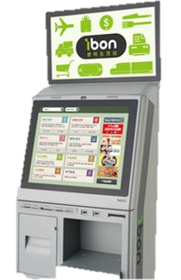
Science
Shopee
tag
Contact information
Notes:
One of the successful example is shopee,

Slide 6
Idea.1
Build an APP for senders
Fixed format to fill in
People can complete by themselves
Save both server’s and customer’s time
Avoid sloppy handwriting
Registered mail
Registered mail
Sender’s info:
Sender’s info:
Name:
Zip code:
Address:
Phone:
Email(optional):
Name: David
Zip code:111
Address: Taipei
Phone: 0989
Email(optional): a@gmail
Receiver’s info:
Receiver’s info:
Name:
Zip code:
Address:
Phone:
Name: Emily
Zip code:300
Address: Hsinchu
Phone: 0910
submit
Notes:
For the problem we mentioned before, we try to build an APP to fix these problem,
because many people don‘t really know how to fill in, this usually spent time for server to explain for.
In this APP the format is fixed, you only need to fill in the information which is needed and press the submit bottom.
After submit, the pre-process is done. It is easier than traditional one, and save both server’s and customer’s time.
In consequence, the server can offer more service in same time.
For the other problem, the traditional register mail information sometimes will be wrote by hand.
Sloppy handwriting can be a factor that the mail was wrong delivery.
The fixed format can prevent this situation from happen

Slide 7
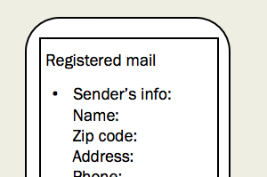

Idea.2
Build a APP for senders
Mail track by sending E-mail
The information of sender’s and receiver’s can be saved in the system
Sender’s info
Common Contact
Sender’s info -1
Receiver’s info -1
Name: Phoebe
Zip code:
Address: Home
Phone:
Email(optional):
Name: Joey
Zip code:111
Address: Taipei
Phone: 0989
Receiver’s info -2
Sender’s info -2
Name: Russ
Zip code:300
Address: Hsinchu
Phone: 0910
Name: Phoebe
Zip code:
Address: Office
Phone:
Email(optional):
common
contact
Name: Rachel
submit
submit
Notes:
This APP give two advance function
the first function provide sender to track whether the mail is delivery or not
Because after register mail sending success, the barcode will be scanned.
and the notification of sending success will be send via email.
the second function is the memory system.
Once customer fill in the information of his, he can next add this information in the system and give it a name.
Such as Home, workplace, children’s dorm.
In the next time, he can choose the information rather than fill in again.

Slide 8
I-P-O Cycle or block diagram
Input
Process
Output
(Data)
- Sender’s information
- Receiver’s information
(Operation)
App processing
- Scan the barcode
Print the info. on the envelope
- Delivery
(Result)
Notify senders via the email
Notes:
Here is our IPO cycle. First we input senders’ and receivers’ contact information in the APP.
Through the APP processing, we can obtain a barcode in exchange for all the information we input.
After the server scans the barcode, the contact information can be printed out and pasted on the envelope.
Hence we can save time and reduce typo simultaneously.
As soon as the mail is delivered, the postman will scan the barcode and the sender can be notified.

Slide 9
Flowchart for preliminary design
start
Print the contact information
Successful or not
No
Yes
Input contact information
Paste on the envelope
send back to post office
Addressee receives the mail
App processing
charge
Notified the sender via e-mail
Notified the sender via e-mail
Output a barcode
Mail is being processing
End
Server scans the barcode
Notes:
At the begining,we input the contact information, after the app’s processing , it will output a barcode, and we can take this barcode to post office. Then, the server will scan the barcode, print the contact information and paste it on the envelope. Next we need to pay for the charge and mail will be processing. After delivering, if mail have been received, post system will notified the sender through e-mail. If sending a letter failed, it will also notified the sender through e-mail.

Slide 10
Q&A

Slide 11
Thank you for your listening

